Slide 1
Power and Efficiency in Rigid Bodies
Dr. Jacob Moore
Associate Professor of Engineering
Penn State Mont Alto

Slide 2
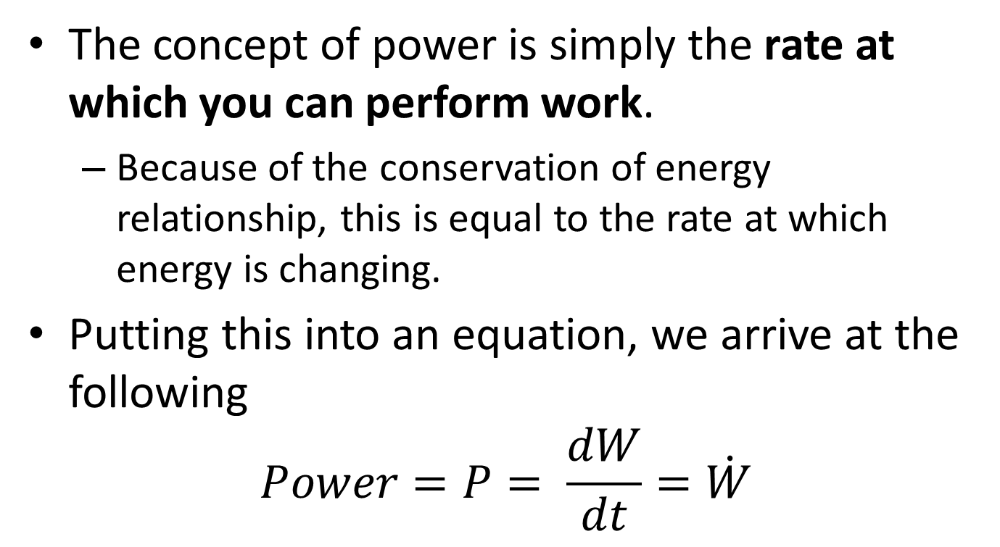
Power
The concept of power is simply the rate at which you can perform work.
Because of the conservation of energy relationship, this is equal to the rate at which energy is changing.
Putting this into an equation, we arrive at the following
$$Power=P= \frac{dW}{dt}=\dot{W}$$

Slide 3
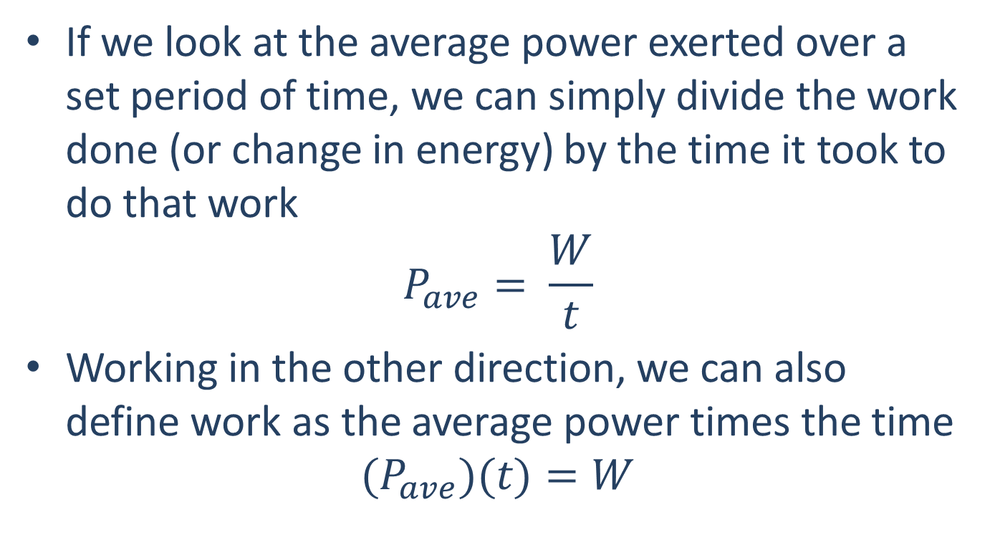
Power
If we look at the average power exerted over a set period of time, we can simply divide the work done (or change in energy) by the time it took to do that work
$$P_{ave}= \frac{W}{t}$$
Working in the other direction, we can also define work as the average power times the time
$$(P_{ave})(t)=W$$

Slide 4
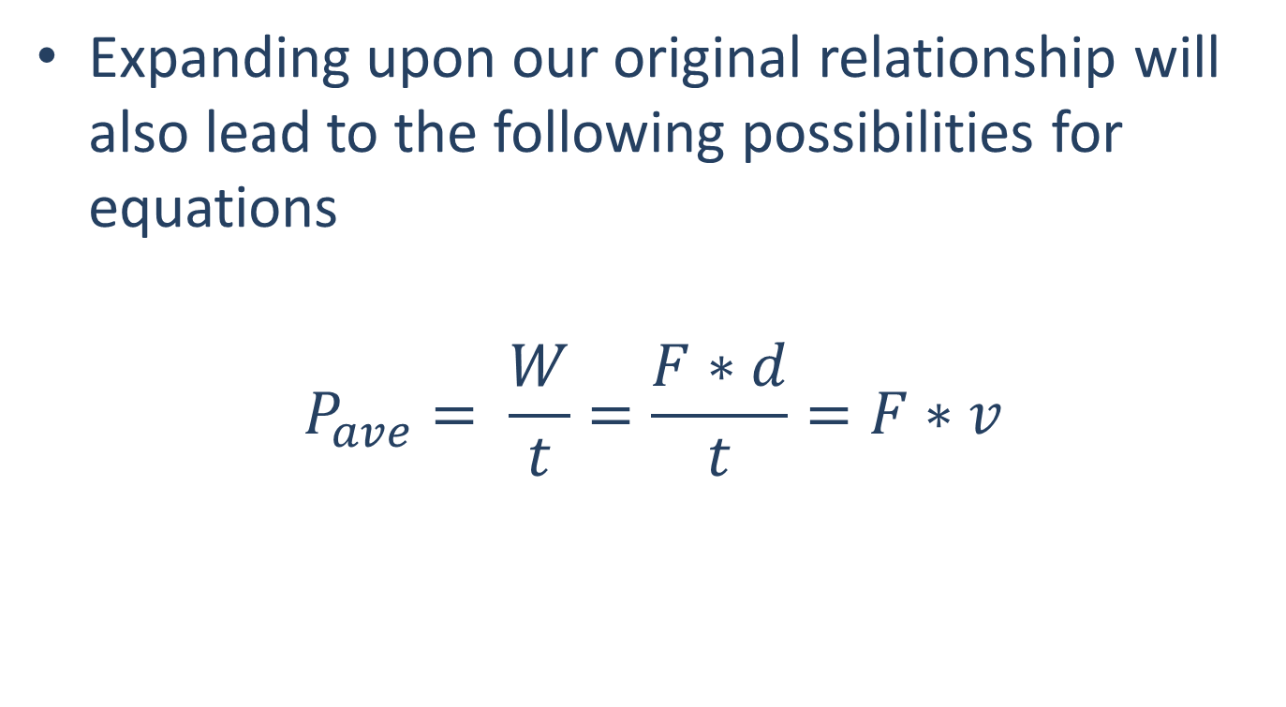
Power in Translational Systems
Expanding upon our original relationship will also lead to the following possibilities for equations
$$P_{ave}= \frac{W}{t}=\frac{F∗d}{t}=F∗v$$

Slide 5
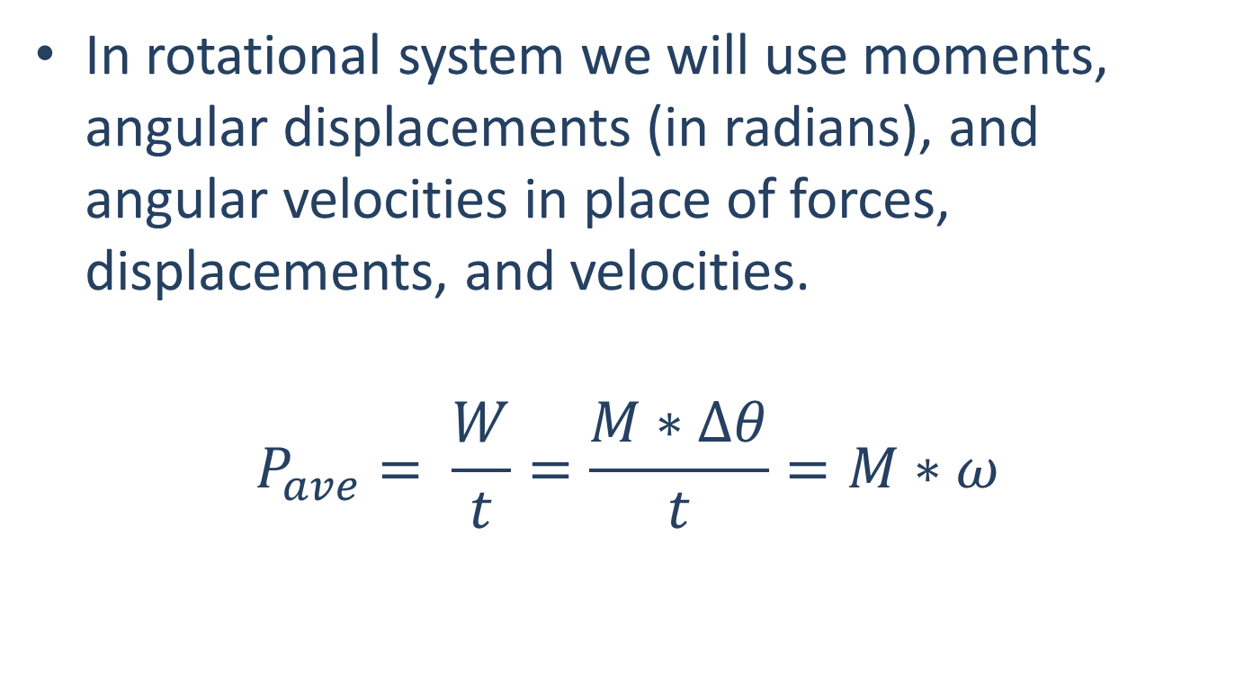
Power in Rotational Systems
In rotational system we will use moments, angular displacements (in radians), and angular velocities in place of forces, displacements, and velocities.
$$P_{ave}= \frac{W}{t}=\frac{M∗∆θ}{t}=M∗ω$$

Slide 6
Power Units
The units of power generally are a unit force times a unit distance per unit time.
In the metric system...
$$Watt=W=1\frac{J}{s}=1\frac{Nm}{s}$$
In the English system...
$$Horsepower=hp=550\frac{ft lb}{s}$$

Slide 7
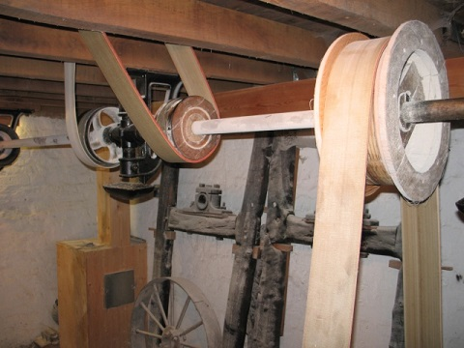
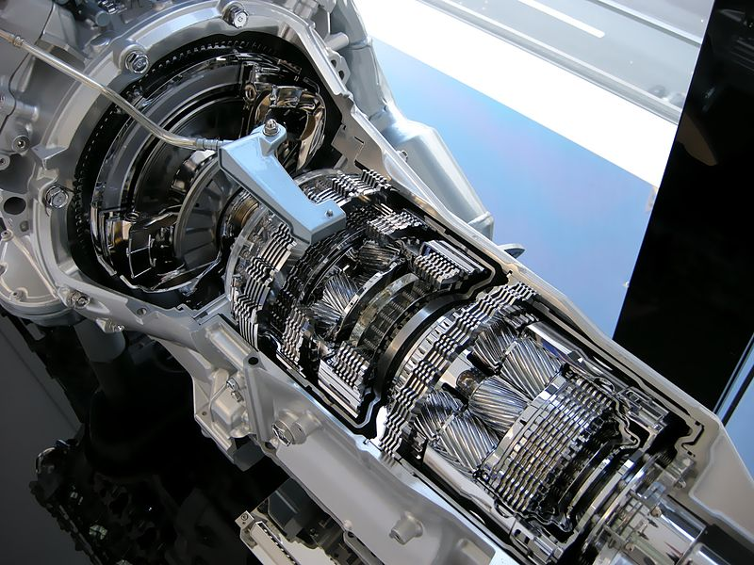
Power Transmission
Engineers will frequently need to transfer work or power from one location to another in a system. A common method for doing this is a combination of shafts, pulleys, and gear trains.
Measuring the angular velocity and torque in a shaft lets us easily identify the power being transferred
While belts and pulleys, along with gear trains will alter the torques and angular velocities, the overall power will remain the same throughout the system, at least ignoring friction losses.
Image by Ian Petticrew CC-BY-SA 2.0
Public Domain Image by Hatsukari715

Slide 8
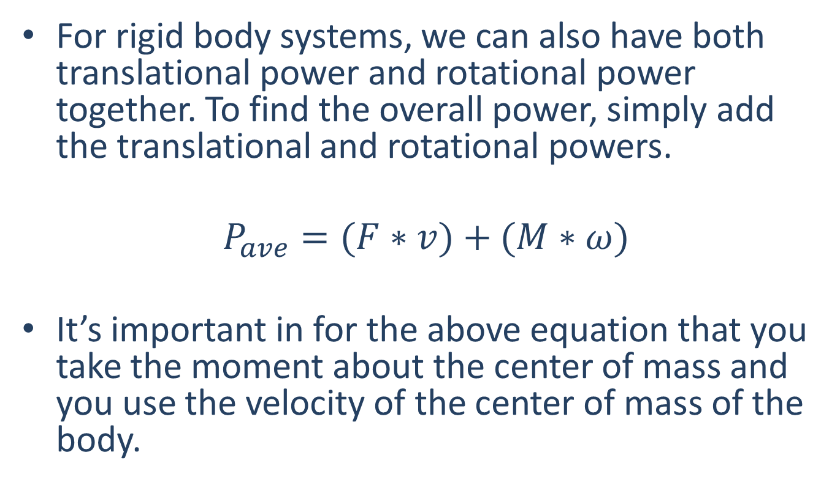
Power in Rigid Body Systems
For rigid body systems, we can also have both translational power and rotational power together. To find the overall power, simply add the translational and rotational powers.
$$P_{ave}=(F∗v)+(M∗ω)$$
It’s important in for the above equation that you take the moment about the center of mass and you use the velocity of the center of mass of the body.

Slide 9
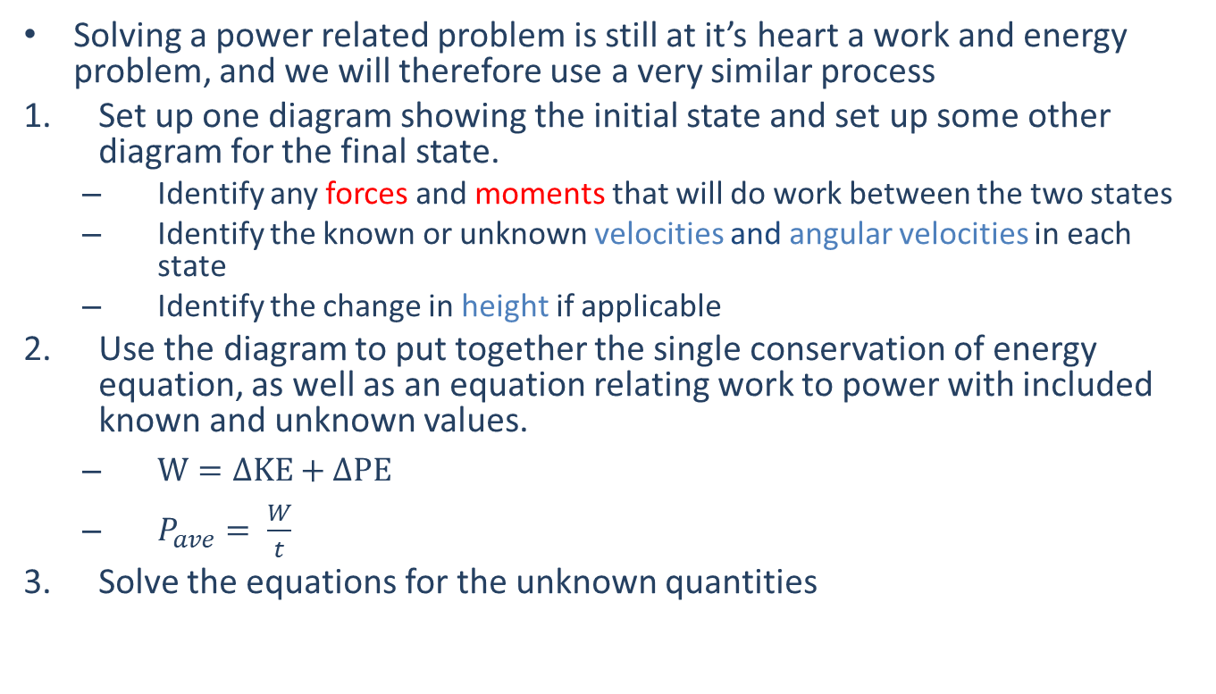
Solving Power Problems (The Process)
Solving a power related problem is still at it’s heart a work and energy problem, and we will therefore use a very similar process
Set up one diagram showing the initial state and set up some other diagram for the final state.
Identify any forces and moments that will do work between the two states
Identify the known or unknown velocities and angular velocities in each state
Identify the change in height if applicable
Use the diagram to put together the single conservation of energy equation, as well as an equation relating work to power with included known and unknown values.
$W=∆KE+∆PE$
$P_{ave}= \frac{W}{t}$
Solve the equations for the unknown quantities

Slide 10
Thanks for Watching
See other engineering mechanics videos and access the full tool at…

Slide 11
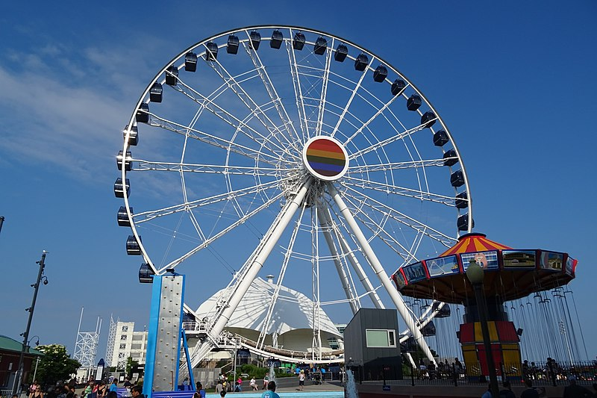
Worked Example
The Ferris Wheel shown below can be approximated as a thin circular ring with a diameter of 96 meters and a mass of 20,000 kg. What is the power required from a motor in order to bring the Ferris wheel from rest to its operating speed of 0.5 rotations per minute over the course of 15 seconds?
Image by Orlandowood365
CC-BY-SA 4.0

Slide 12

Worked Example
A small off-road trailer can be approximated as a rectangular prism with a mass of 100kg supported by two wheels each approximated as thin circular discs with as mass of 25 kg and a diameter of 60 cm. Assuming the wheels roll without slipping, what is the power required to bring the trailer from rest to a speed of 80 kph over the course of 10 seconds?

Slide 13
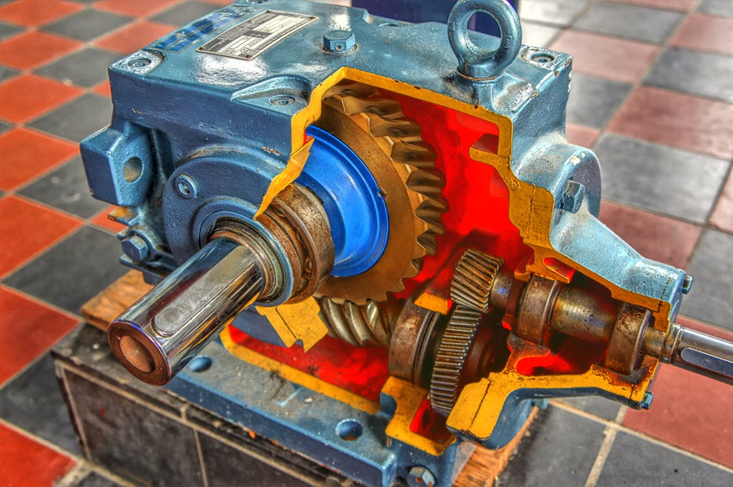
Worked Example
The input to a gearbox has a measured 32 ft lbs of torque at 700 rpm. The output has 207 ft lbs of torque at 100 rpm.
What is the power input?
What is the power output?
What is the efficiency of the gear train?

Slide 14
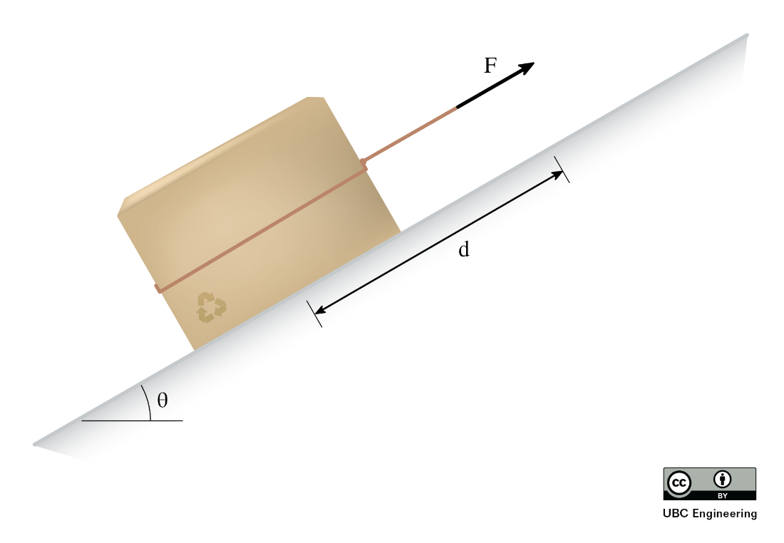
Worked Example
You ask your little cousin to move a 1 kg box up a hill with a coefficient of kinetic friction μ_{k}=0.2. Rather than carrying the box, he overthinks things and drags the box up the hill with a rope. Determine the average power exerted by your little cousin if he applies a force F=10 N and he drags the box up the hill d=3 m with an incline of θ=30 degrees.

